Slide 1
مقاله نویسی
Presented by: Dr.Hamed Kord Varkaneh
Hamedan University of Medical Sciences,
Tehran, Iran

Slide 2
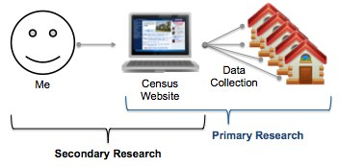
Types of studies
Secondary studies
primary studies

Slide 3
The concept of primary and secondary studies
Preliminary studies: examining and extracting information directly from the samples
Secondary studies: synthesis and analysis of information from primary studies

Slide 4
Secondary studies
primary studies
primary studies
primary studies
Secondary studies

Slide 5
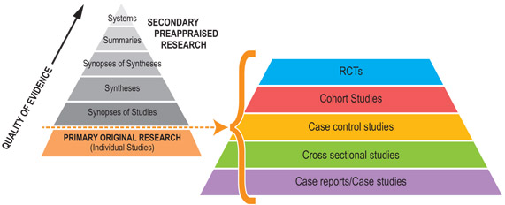

Slide 6
Choose a topic
The research subject should:
It is important and should be of interest to researchers and specialists.
There is a difference of opinion between experts and in books and scientific sources and articles
It is better for the researcher to have specialization and expertise in that field

Slide 7
Research question
What is the purpose of the research?

Slide 8
Question components : PICOS
What types of Participants?
What types of Interventions?
What types of Comparisons?
What types of Outcomes?
What types of Study design?
Notes:
از این رو سوال تحقیق باید ساختار یافته باشد...یعنی اجزاء مشخص داشته باشد...

Slide 9
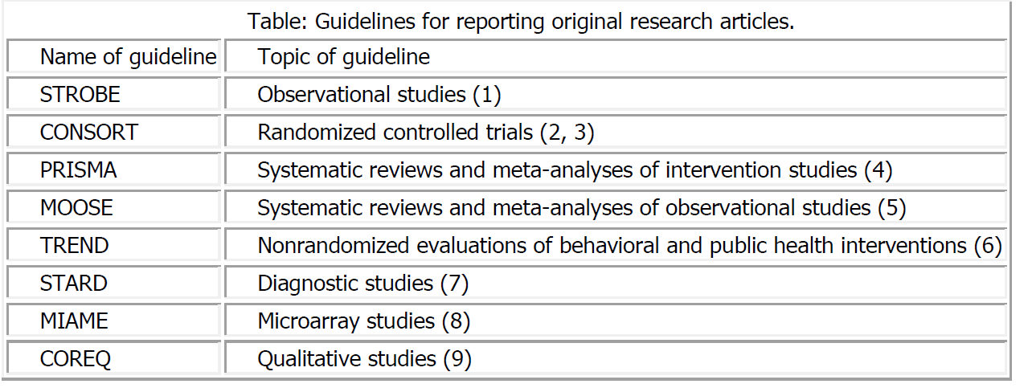

Slide 10
How to find the title؟
Search in reliable databases and journal

Slide 11
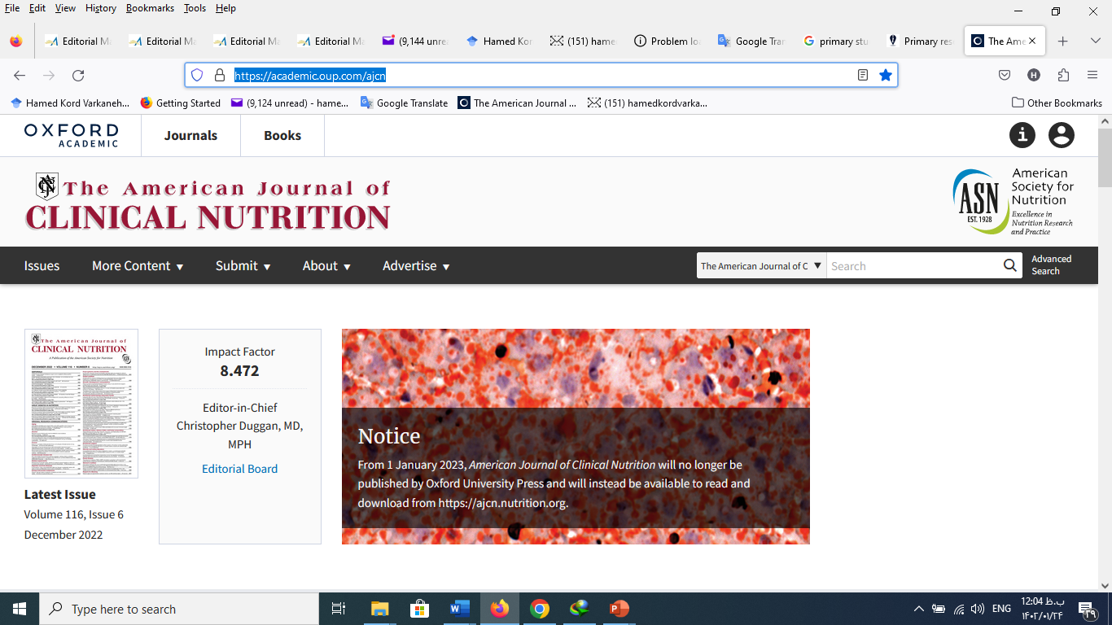

Slide 12
Identify Subject Headings and Key Words
Concept #1
Concept #2
Concept #3
OR | “???"[Mesh] | AND | “???"[Mesh] | AND | “???"[Mesh]
OR
OR
OR | “???"[tiab] |  | “???"[tiab] |  | “???"[tiab]
OR | “???"[tiab] |  | “???"[tiab] |  | “???"[tiab]
Subject Headings
Text
Words

Slide 13
L-arginine AND obesity
#1 ((((((("Arginine"[Mesh]) OR "Arginine"[tiab]) OR "L-arginine "[tiab]) OR "L-Arg"[tiab]) OR "Arg"[tiab]))
#2 ("Obesity"[Mesh] OR "Weight Loss"[Mesh] OR "weight reduce"[tiab] OR "weight decrease"[tiab] OR "weight change"[tiab] OR "Body Weight"[Mesh] OR "Obesity, Abdominal"[Mesh] OR "Body Mass Index"[Mesh] OR "Waist Circumference"[Mesh] OR "Weight Loss"[tiab] OR obes*[tiab] OR "central obesity "[tiab] OR "Body Mass Index"[tiab] OR "overweight" [tiab] OR "body weight" [tiab] OR "adipose tissue" [tiab] OR "fat mass" [tiab] OR "adiposity" [tiab] OR "Waist Circumference"[tiab]))
#3 ((((((((("Intervention Studies" [tiab]) OR "intervention"[tiab]) OR "controlled trial"[tiab]) OR "randomized" [tiab]) OR "randomised"[tiab]) OR "random"[tiab]) OR "randomly"[tiab]) OR "placebo"[tiab]) OR "assignment"[tiab])

Slide 14
SPSS

Slide 15
STAT

Slide 16
How to write different parts of the article
Title
Abstract
Methods and meterials
Results
Discussion

Slide 17
Preparing the article for submission
Work with endnote
Find a suitable journal
How to register and submit to the journal site

